Slide 1
Capstone project finding report
NAGARAJAH Sailajan
November 25th, 2023

Slide 2



OUTLINE
Executive Summary
Introduction
Methodology
Results
Visualization – Charts
Dashboard
Discussion
Findings & Implications
Conclusion
Appendix

Slide 3

EXECUTIVE SUMMARY
This document is the data findings report of the IBM Data Analyst Capstone project. It gathers and summarizes all the work and findings done using methods of data analytics and is a testimony of everything learned in the IBM Data Analyst professional certificate.

Slide 4

INTRODUCTION
Stack Overflow, a popular website for developers, conducted an online survey of software professionals across the world. The survey data was later open sourced by Stack Overflow. The actual data set has around 90,000 responses.
Randomized subset contains around 1/10th of the original data set.
Goal: Determine the current and future trends of the market.

Slide 5

METHODOLOGY
Collecting Data
Using APIs
Using webscrapping
Exploring Data
Data wrangling
Finding and removing duplicates
Imputing missing values
Normalizing Data
Exploratory Data Analysis
Analyzing the data distribution
Handling outliners
Correlation
Data visualization
Visualizing distribution of data
Visualizing relationship
Visualizing composition and comparison of data
Dashboard

Slide 6
RESULTS
Programming language trends
Database trends
Platform trends
WebFrame trends
Demographic distribution

Slide 7
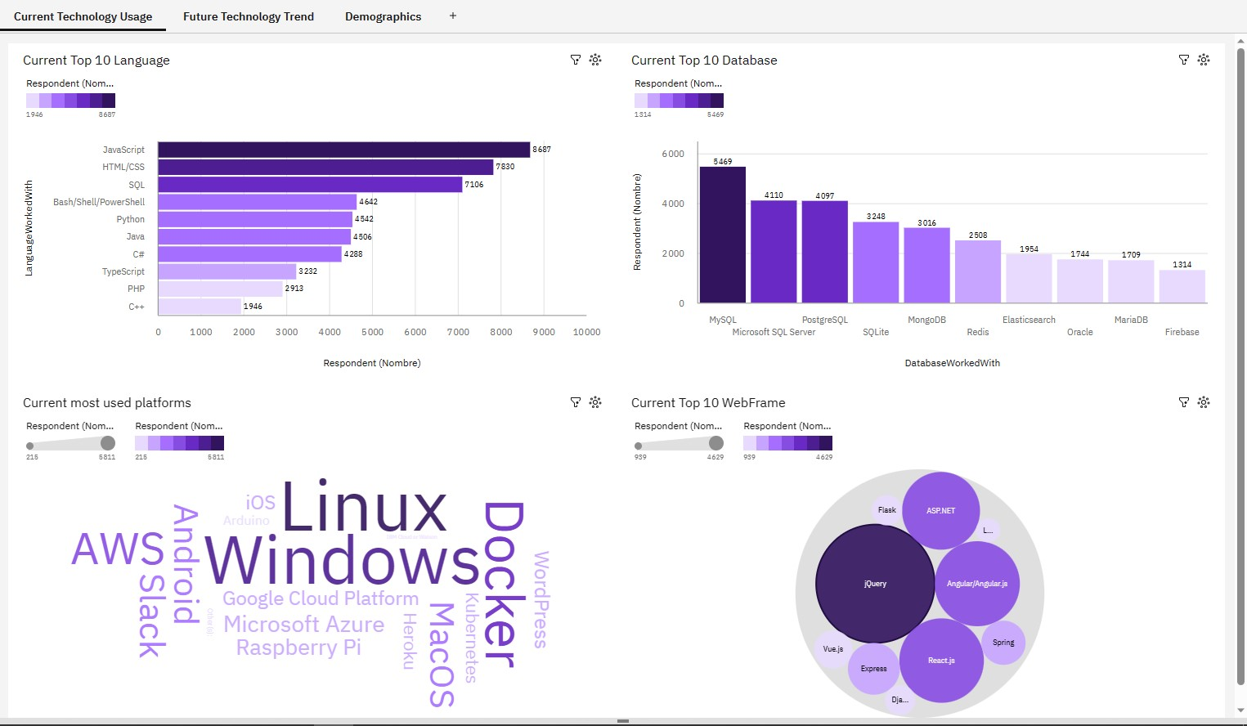
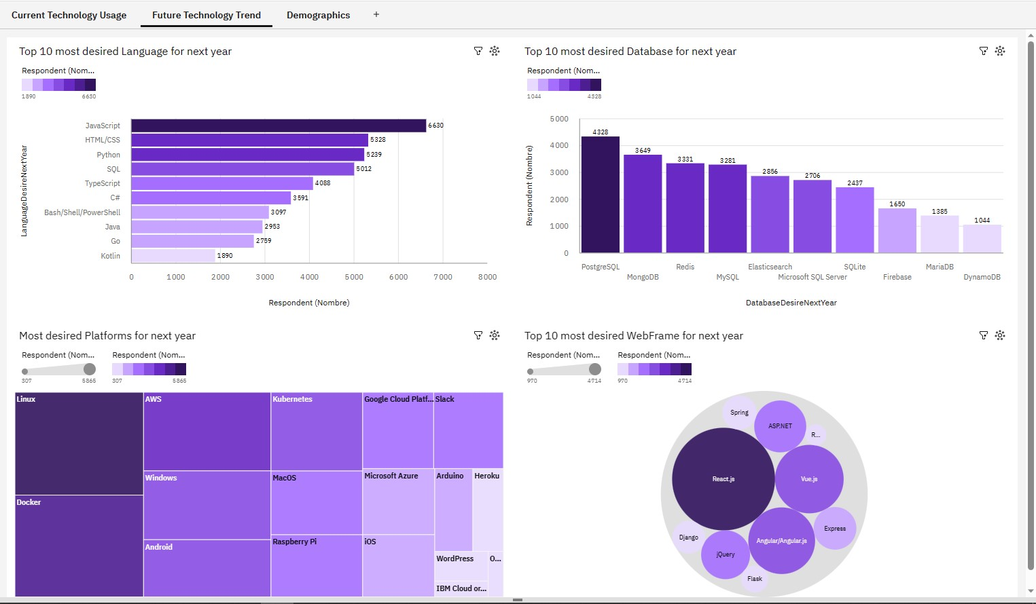
PROGRAMMING LANGUAGE TRENDS
Current Year
Next Year

Slide 8
PROGRAMMING LANGUAGE TRENDS - FINDINGS & IMPLICATIONS
Findings
Different Top 10
JavaScript and HTML/CSS are still Top 2
Python makes 3rd place
Implications
New trending programming languages
Strong Top 2
Progression of Python

Slide 9
DATABASE TRENDS
Current Year
Next Year

Slide 10
DATABASE TRENDS - FINDINGS & IMPLICATIONS
Findings
SQL still in Top 10
Oracle out Top 10
MySQL loses three places
Implications
Strong presence of SQL
New trends
PostgreSQL makes 1st place

Slide 11

DASHBOARD
IBM Cognos Analytics Dashboard

Slide 12
DASHBOARD TAB 1

Slide 13
DASHBOARD TAB 2

Slide 14
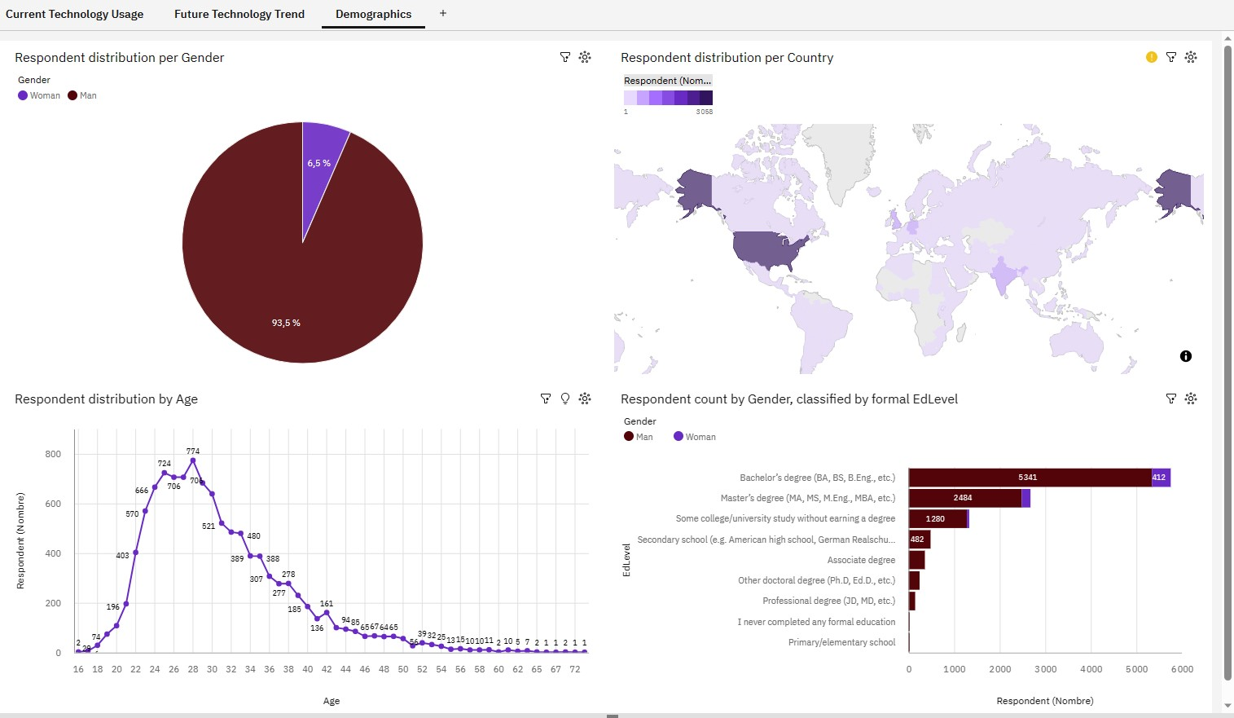
DASHBOARD TAB 3

Slide 15

DISCUSSION
90%+ of the respondents are men
Most respondents are 18-40 years old
Most respondents have a Bachelor’s or a Master’s Degree
Most respondents are from the USA

Slide 16
OVERALL FINDINGS & IMPLICATIONS
Findings
New programming language trends
New database trends
90%+ men respondents
Implications
Constant evolving market
Predominantly male market

Slide 17

CONCLUSION
Stack Overflow, a popular website for developers, conducted an online survey of software professionals across the world.
The market is constantly evolving, with new trends every year.
The market requires higher education level.
The market is predominantly male.
The market is growing with new professionals every year across the globe.

Slide 18
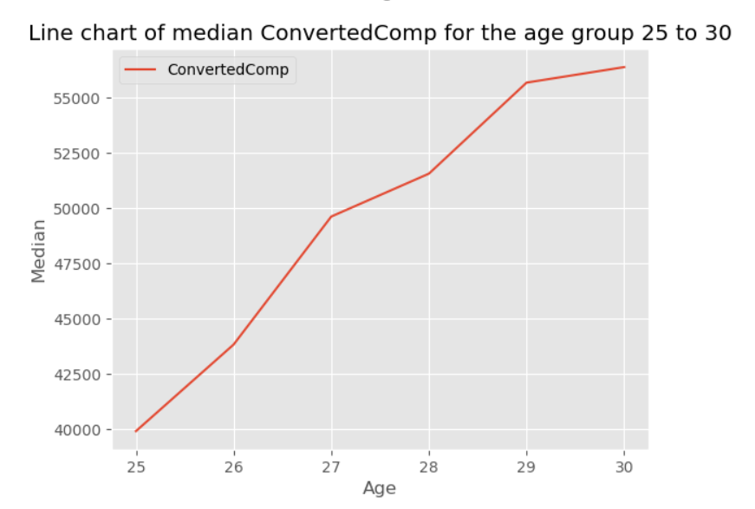
APPENDIX
Line chart

Slide 19
JOB POSTINGS
In Module 1 you have collected the job posting data using Job API in a file named “job-postings.xlsx”. Present that data using a bar chart here. Order the bar chart in the descending order of the number of job postings.

Slide 20
POPULAR LANGUAGES
In Module 1 you have collected the job postings data using web scraping in a file named “popular-languages.csv”. Present that data using a bar chart here. Order the bar chart in the descending order of salary.

